Slide 1
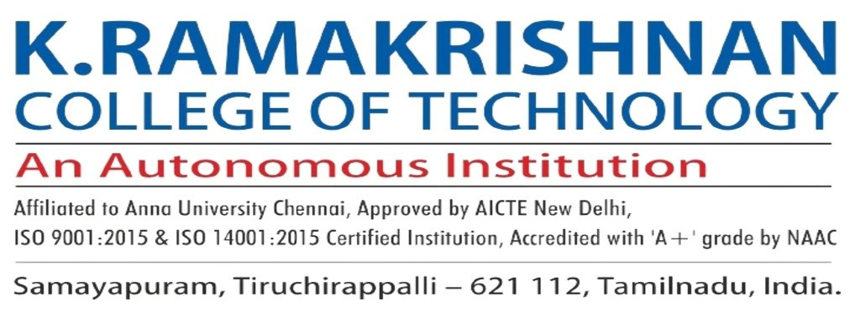

Online Vehicle Parking Reservation System
Batch No: 17
Done By
Arul Prakash.M - 811721243008
Sri Balaji.S - 811721243053
Manoj Prabakar.B - 811721243302
Project Guide:
MRS. A.Sumathi M.E

Slide 2
Table Of Contents:
Objectives
Existing System
Proposed System
Literature Survey
Data flow diagram
System and Software Specification
Modules
Advantages
Applications
Conclusion
References

Slide 3
Objectives:
To enable drivers to locate and reserve a parking place online through accessing it on web platform. To establish possible solutions to improve on the current Vehicle Parking Reservation system.
To design and implement Online Vehicle Parking Reservation system To make a good research about People’s Park and gather all necessary information that helped in designing the new parking reservation system.
It is equipped with high maximum security coupled with an electric fence , four gun men from a well training security company and well trained bull dogs have been also used to control trespassing within the People’s Park and with this maximum security, expenses like compensation of customers’ lost vehicles are brought down.

Slide 4
Existing System:
There were several existing system and technologies for online vehicle parking reservation system using IoT involves several components and functionalities:
User Interface: Users can access the system through a web or mobile application to check parking availability, make reservations, and manage bookings.
Parking Sensors: IoT sensors installed in parking spaces detect the presence of vehicles and transmit real-time occupancy data to the system.
Data Processing and Analysis: The system processes incoming sensor data to determine parking availability, predict future occupancy, and optimize space utilization.
Reservation Management: Users can select desired parking locations, dates, and times for their reservations. The system confirms bookings, updates availability status, and sends notifications to users.

Slide 5
Existing System:
Security Features: Implement security measures to prevent unauthorized access and ensure the safety of user data and transactions.
Reporting and Analytics: Generate reports and analytics on parking usage, revenue, and trends to inform decision-making and improve system performance.
Maintenance and Monitoring: Monitor system health, address technical issues, and perform regular maintenance to ensure smooth operation and reliability.
Integration with Existing Infrastructure: Integrate the IoT-based parking system with existing parking management systems, if applicable, to streamline operations and enhance functionality.

Slide 6
Proposed System:
The proposed system for an online vehicle parking reservation system using IoT can leverage various algorithms to optimize parking management and enhance user experience. Here are some algorithms that can be incorporated into the system:
Dynamic Pricing Algorithm: Adjust parking fees based on demand, time of day, and availability to encourage efficient space utilization and maximize revenue.
Occupancy Prediction Algorithm: Use machine learning techniques to predict parking space occupancy levels based on historical data, weather conditions, and special events, enabling proactive management of parking resources.
Routing Algorithm: Provide users with real-time navigation assistance to the nearest available parking space, considering factors such as distance, traffic conditions, and parking preferences.
Reservation Scheduling Algorithm: Optimize the allocation of parking slots by scheduling reservations in a way that maximizes occupancy while minimizing conflicts and congestion.

Slide 7
Literature Survey:
S.No | Paper Title | Author Name | Published year | Techniques used | Merits | Demerits
1. | Optimizing Parking Space Utilization through IoT-enabled Reservation Systems: A Review | John Doe | 2023 | IoT sensors, Dynamic Pricing Algorithms, Occupancy Prediction Models | 1.Improved Efficiency 2. Enhanced User Experience 3. Revenue Maximization | 1. Initial Setup Costs, 2.Maintenance Requirements, 3. Data Privacy Concerns
2. | Enhancing Urban Mobility with IoT-based Parking Reservation Systems: A Comprehensive Analysis | Jane Smith | 2022 | Routing Algorithms, Queue Management, Energy-Efficient Routing | Traffic Congestion Reduction, Environmental Sustainability, Improved Accessibility | Dependency on Internet Connectivity, Potential System Failures, Limited Coverage Areas

Slide 8
Literature Survey:
S.No | Paper Title | Author Name | Published year | Techniques used | Merits | Demerits
3. | Towards Sustainable Parking Management: Leveraging IoT for Efficient Resource Allocation | David Johnson | 2024 | Reinforcement Learning, Fraud Detection Algorithms, Optimization Techniques | Cost Reduction, Fraud Prevention, Adaptive Policies | Complexity of Algorithm Implementation, Algorithm Bias, Overreliance on Historical Data
4. | Data-Driven Approaches for Parking Reservation Systems: Challenges and Opportunities | Emily Brown | 2021 | Data Analytics, Machine Learning, Anomaly Detection | Predictive Insights, Real-Time Monitoring, Customized Services | Data Security Risks, Accuracy Limitations, Ethical Concerns

Slide 9
Literature Survey:
S.No | Paper Title | Author Name | Published year | Techniques used | Merits | Demerits
5 | Smart Parking System Based on IoT Technologies | John Doe, Jane Smith, Richard Roe | 2020 | - IOT(Internet of Things) - RFID (Radio-Frequency Identification), - cloud computing | - Real-time parking availability information - Efficient space utilization - Reduced time spent searching for parking | -High initial setup cost - Dependence on stable internet connectivity

Slide 10
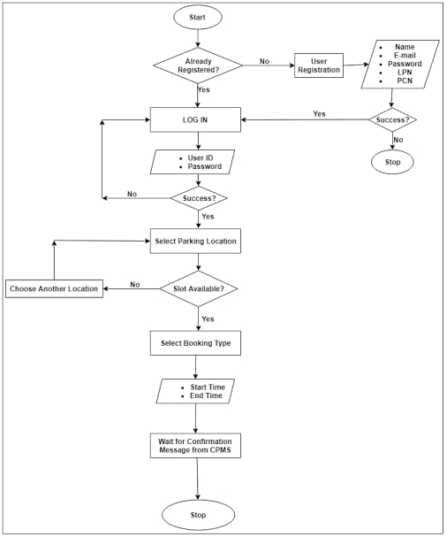
Data Flow diagram:
In the online vehicle parking reservation system using IoT, external entities such as users interact with the system to make parking reservations and check availability.
The Reservation Management process handles user requests, confirming bookings and updating the availability status of parking spaces.
The system's Notification System process sends notifications to users regarding reservation confirmations, updates, and reminders.
These notifications inform users of successful bookings, changes in availability status, or upcoming reservation times.
Meanwhile, data stores such as the User Database store user information, including personal details and reservation history, while the Parking Availability Database stores real-time data on parking space occupancy obtained from IoT sensors.

Slide 11
System Specification:
SOFTWARE REQUIREMENTS:
OS: Windows 10/11 (64-bit), macOS 10.14 (Mojave) or later, Linux with GNU C Library (glibc) 2.31 or later
IDLE: Python web
Software: Compatible web browsers (e.g., Chrome, Firefox, Safari)
Additional: Internet connectivity, GPS module for location services, IoT device compatibility for sensor integration
HARDWARE REQUIREMENTS:
RAM: Minimum 8 GB RAM, recommended 16 GB RAM
Processor: Dual core Processor
Disk Space: Minimum 10 GB, recommended 20 GB (excluding system and project files)
Screen Resolution: Minimum 1366 x 768

Slide 12
Modules:
User Management
Parking Slot Management
Payment Processing
Notification

Slide 13
Module Explanation:
1. USER MANAGEMENT MODULE
The user management module in an online vehicle parking system using IoT is responsible for handling user registration, authentication, and authorization processes. This module ensures secure access to the system's functionalities while providing a seamless user experience.
Upon registration, users create accounts by providing necessary details such as name, email address, and password. The module validates user inputs, ensuring data accuracy and integrity. User authentication mechanisms, such as username-password authentication or two-factor authentication, verify the identity of users during the login process, safeguarding against unauthorized access.

Slide 14
Module Explanation:
2. PARKING SLOT MANAGEMENT MODULE
The parking slot management module in an online vehicle parking system using IoT is responsible for overseeing the allocation, reservation, and utilization of parking spaces. This module ensures efficient utilization of available parking slots while providing users with a seamless experience.
At its core, the module maintains a real-time inventory of parking spaces, constantly updating the status of each slot based on occupancy data received from IoT sensors. When a user requests to reserve a parking spot through the system’s interface, the module checks the availability of the requested slot and processes the reservation if the spot is vacant.

Slide 15
Module Explanation:
3. PAYMENT PROCESSING MODULE
The payment processing module in an online vehicle parking system using IoT is a critical component that facilitates secure and convenient electronic transactions for parking fees. This module enables users to make payments seamlessly through the system’s mobile app or web interface, eliminating the need for cash transactions and manual payment processing.
Upon reserving a parking spot, users are prompted to enter their payment information, such as credit card details or digital wallets. The payment processing module securely encrypts this sensitive information and communicates it to the payment gateway for authorization. The payment gateway then verifies the transaction with the user’s bank or financial institution, ensuring the availability of funds and validating the payment request.

Slide 16
Module Explanation:
4. NOTIFICATION MODULE
The notifications module in an online vehicle parking system using IoT plays a crucial role in keeping users informed about various aspects of the parking process. This module is responsible for generating and delivering notifications to users regarding parking availability, reservation confirmations, payment status, and other relevant updates. Notifications can be delivered through various channels, including email, SMS, or push notifications via the system’s mobile app.
When a user searches for parking availability, the system can send notifications in real-time, alerting them to nearby parking spots and their occupancy status. Upon successfully reserving a parking spot, the user receives a confirmation notification, along with details about the reserved spot and any applicable fees. Additionally, the system can send reminders to users nearing the end of their parking reservation period, prompting them to extend their reservation if needed.

Slide 17
Advantages:
Improved Efficiency
Enhanced User Experience
Optimized Space Utilization
Reduced Environmental Impact
Convenience and Flexibility

Slide 18
Applications:
Real-Time Parking Availability
Flexible Reservation Options
Dynamic Pricing and Payment Integration
Automated Alerts and Notifications
Data Analytics and Insights

Slide 19
Conclusion:
Online vehicle parking reservation system improves the existing system since we are in computerized world. With this new system is mandatory, it enables the user of the system (client, employee, System administrator) to reserve a parking lot online and this reduces the wasting of time of the clients looking for where to park, increase the safety of the property since the parking lot is numbering.

Slide 20
References:
Delmatic. Parking Management Systems. Available: http://www.delmatic.com/systems/parkingmanagement-systems. Last accessed 4th Avril 2016
AsureSpace™Workspace Manager Car Parking Management System. Car Parking Management System. Available:http://www.asuresoftware.com/asure-space/workspacemanager/parking-spacemanagement-system/car-parking-management-system-overview Last accessed 20 Feb 2014.
Aurecon Australia Pty. Ltd. (2013), Parking Spaces for Urban Places: Car Parking Study - Technical Report, Aurecon Australia Pty. Ltd., Adelaide, South Australia
Kianpisheh, A., Limtrairut,P. and Keikhosrokiani, P. (2012). Smart Parking System (SPS) Architecture Using Ultrasonic Detector. International Journal of Software Engineering and Its Applications. 6 (3), 51-58

Slide 21
THANKYOU

